Slide 1

Software Design and Architecture [Week01 & 2 – Introduction]

Slide 2
Lecture Outlines
Software engineering (revised)
Problem solving
Software engineering design
Why study software engineering design
Software design challenges
Software design process
Software design fundamentals

Slide 3
Software Engineering (revised)
Software
    is a collection of instructions that enable the user to interact with a computer, its hardware, to perform tasks.
Engineering
    A systematic process in which designers generate, and evaluate designs for devices, systems or processes whose function(s) achieve clients’ objectives and users’ needs while satisfying a specified set of constraints.
Software engineering:
    According to the IEEE, Software Engineering is:
    The application of a systematic, disciplined, and quantifiable approach to the development, operation, and maintenance of software; that is, the application of engineering to software.

Slide 4
Software Engineering (revised)
What do we mean by systematic?
  Presented or formulated as a coherent body of ideas or principles
  Methodical in procedure or plan
What do we mean by disciplined?
  A rule or system of rules governing conduct or activity
What do we mean by quantifiable?
  To determine, express, or measure the quantity of deliverables

Slide 5
Software Engineering (revised)
The process of software engineering supports a systematic, disciplined, and quantifiable approach to software product development, and includes the following phases:
Requirements
Design
Implementation
Testing
Maintenance
requirements are analyzed, specified, and validated.
the requirement’s specification is used to create the software design which includes its architecture and detailed design.
relies on the requirements’ specification, the software architecture, the detailed design to implement the solution using a programming language
insures that the software behaves correctly and meets the specified requirements
Modifies software after delivery to correct faults, improve performance, or adapt it for a different environment

Slide 6
Software Engineering (revised)
Design allows teams to organize in disciplined manner and provides a systematic approach to carefully ensure that products are built to meet their specification
During the design process, engineers are constantly engaging in problem-solving activities. Their work requires them to identify, evaluate, and propose solutions to complex problems.
To become a good designer, engineers must be good problem solvers and to become a good problem solver… well, that requires lots of time and effort
Requirement
Design
Implementation
Testing
Maintenance

Slide 7
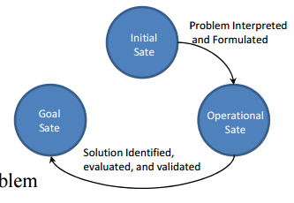
Engineering Problem-solving
In general, problem-solving during design occurs in three different states:
Initial State
  Problems are formulated and interpreted
In some cases, understanding the problem is a problem itself.
Operational State
  Once problem is understood, operational state begins
  Thinking about the problem and viable solutions come to light
Goal State
  Once an appropriate solution is identified, evaluated, and validated, goal state is reached
  Final solution found, marking the end of the problem-solving process

Slide 8

Engineering Problem-solving
Try solving the following puzzle problem using the figure to the right and the following requirements:
  Draw four straight lines to connect all dots.
  The pencil cannot be lifted from the paper once the line-drawing process begins.
  No lines can be retraced.
  A line must pass through every dot.
  Are there any constrains??? What are they?

Slide 9

Engineering Problem-solving
Most students presumed that lines should begin and end on a dot although this was not specified in the requirements from previous slide
This behavior is an example of functional fixedness
functional fixedness limits the ability to find solutions based on objects having a different function from their usual ones.
Sometimes, problem-solving requires a “think outside the box” mentality :)
To increase our chance in overcoming this issue, problems need to be attempted several times and considered from many different view points and unusual angles
Overcoming functional fixedness is critical for designers attempting to provide solutions at the operational stat of problem solving.
Possible solution

Slide 10
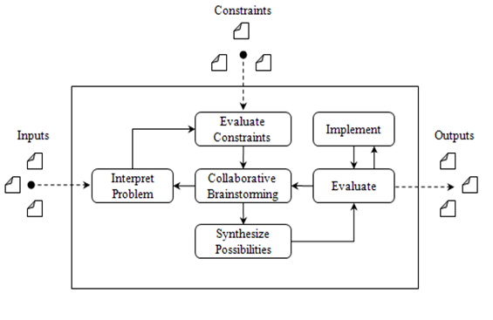
Engineering Problem Solving – A holistic Approach
The concepts of initial, operational, and goal state of problem solving can be fused together to create a holistic problem-solving framework adequate to solving engineering problems at all stages of the development. The framework consists of the following tasks:
  Interpreting the problem
  Evaluating the constraints
  Collaborative brainstorming
  Synthesizing the possibilities
  Evaluating the solution
  Implementing the solution
Initial state
operational
state
Goal state

Slide 11
Engineering Problem Solving – A holistic Approach
Interpreting the problem
  Performed during the Initial State of problem-solving
  Understand and classify the problem
Evaluate constraints
  Identify external constraints to set bounds on the solution landscape.
Collaborative brainstorming
  Performed during the Operational State of problem-solving.
  Think about different possible solutions to the problem
Synthesize the possibilities
  Performed during the Operational State of problem-solving.
  Try to choose one acceptable solution.
Evaluate solution
  Performed during the Operational State of problem-solving.
  Flaws in the selected solution may trigger a transition back to the collaborative brainstorming activity.
Implementing solution
  Performed in the goal state of problem-solving
  After finding a suitable solution, implementation can start

Slide 12
Software Engineering Design
Formally, software engineering design is defined as:
  (1) The process of identifying, and evaluating the architectural, and detailed models required to build software that meets its intended functional and non-functional requirements; and,
  (2) the product of such process. (i.e. the produced design diagrams or documents)

Slide 13
Software Engineering Design
In the software industry, the term design is used interchangeably to describe both the process and product resulting from such process.
  From the process perspective, it describes the phase activities and tasks required to model software’s structure and behavior before construction.(This is concerned mostly with the project management’s aspect of development.)
  From the product perspective, it describes artifacts resulting from design activities, e.g., class diagram. (This is concerned mostly with the technical aspects of development.)

Slide 14
Why Study Software Engineering Design??
Notes:
Here students will discuss why it is important for us engineers to study software engineering design.
Possible reasons:
From the product development’s perspective, studying software design is important, mainly, because:
Requirements are mapped to conceptual models of software
Provide models that represent structure and behavior of the software system
Main components and interfaces are identified
Provide means to evaluate quality attributes, e.g., usability, efficiency, …
Solutions can be reused in other projects
Design forms the foundation for all other development activities: Construction, Testing, Maintenance
From the project management’s perspective, studying software design is important, mainly because:
Good software design help minimize effects of requirements’ volatility
Increases efficiency in human resource allocation.
Shields the project from having “one guy” owning the whole system.
Overall, design helps improve project management: planning, organization, staffing, and tracking

Slide 15
Possible reasons
From the product development’s perspective, studying software design is important, mainly, because:
  Requirements are mapped to conceptual models of software
  Provide models that represent structure and behavior of the software system
  Main components and interfaces are identified
  Provide means to evaluate quality attributes, e.g., usability, efficiency, …
  Solutions can be reused in other projects
  Design forms the foundation for all other development activities: Construction, Testing, Maintenance
From the project management’s perspective, studying software design is important, mainly because:
  Good software design help minimize effects of requirements’ volatility
  Increases efficiency in human resource allocation.
  Shields the project from having “one guy” owning the whole system.
  Overall, design helps improve project management: planning, organization, staffing, and tracking

Slide 16
Major Software Design Challenges
The increasing complexity of today’s software systems makes it challenging for software engineers to develop high quality software. Major design challenges include:
  Requirements volatility
  Inconsistent development processes
  Fast, and ever-changing technology
  Managing design influences
  Ethical and Professional Practices

Slide 17
Software Design Challenge #1 – Requirement Volatility
Requirements volatility refers to growth or changes in requirements during a project’s development lifecycle.
Requirements changes are costly, particularly in the later stages of the lifecycle process, Why???
This is because the change may require rework of the design, verification and deployment plans

Slide 18
Software Design Challenge #2 – Inconsistent development processes
In the design phase, processes involve a set of activities and tasks required to bridge the gap between requirements and construction. For example:
  Architectural and detailed designs
  Design reviews
  Establishing quality evaluation criteria
  Establishing design change management and version control
  Adopting design tools
  …
The problem is that in many cases, a company’s design process
  is not well established,
  is poorly understood,
  is focused on one form of design activity, e.g., user interface, while ignoring others, or,
  is simply, not done at all!

Slide 19
Software Design Challenge #3 – The Technology
The technology for designing and implementing today’ software systems continues to evolve to provide improved capabilities. Can you give me some examples??
As new technologies emerge, software designers are required to understand and employ them all at the same time!!
This creates a demand for capable designers that can assimilate new concepts and technology quickly and effectively.
Why this is challenging?
  This is challenging because of the time required for both learning new technology and completing a project on-time, while making sure that the new technology interoperates well with old legacy systems.

Slide 20






Software Design Challenge #4 – Managing Design influences
Software projects can have a multitude of stakeholders, each with specific wants and needs that influence the software design.
  Some conflicting with each other!
  Each stakeholder believes he/she is correct.
This requires some design trade-offs to satisfy each customer.
  Difficult to do in large-scale systems!
This is difficult to do since design decisions need to accommodate all concerns without negatively affecting the project
I want performance!
I want Usability!
I want Security!
Yikes!

Slide 21
Software Design Challenge #5 – The Ethics
Designers are required to consider how design decisions affect the environment and the people that uses the software.
Designers must exhibit strong ethical and professional practices to ensure that they produce high quality systems
This requires designers to employ strong leadership skills to:
  Influence and negotiate with stakeholders and motivate the development team
This is challenging under numerous pressures from different stakeholders, e.g., management, customer, peers, etc.
An example is the ACM Code of Ethics and Professional Conduct
  http://www.acm.org/about-acm/acm-code-of-ethics-and-professional-conduct

Slide 22
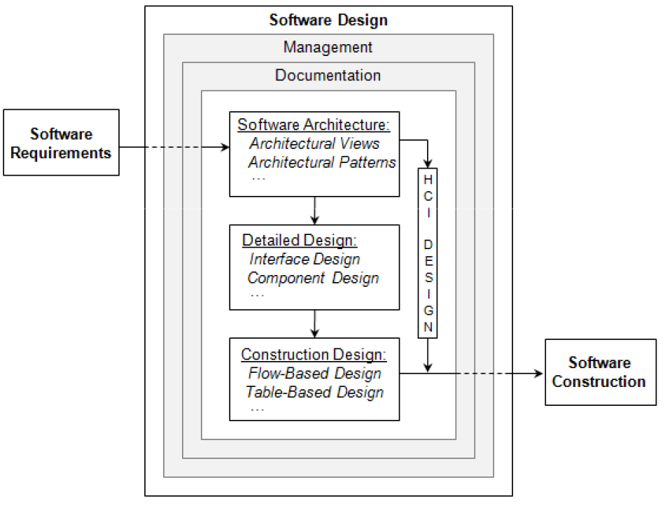
Software Design Process
Software Engineering Design 🡪
process & product
A software design process is a set of activities that specify how resources work together for the production of software design products (e.g., use cases, class diagrams, and other Unified Modeling Language (UML) models, and design documents).

Slide 23
Software Design Process
Software design process include major and supportive activities:
  Software architecture
  Detailed design
  Construction design
  Human-computer interface design
  Software design documentation
  Management activities
Major
activities
Supporting
activities

Slide 24
Software Design Process
Software Architecture
  Corresponds to a macro-design approach for creating models that show the quality and function of the software system
  Provides black-box models used to evaluate the system’s projected quality and functions
  Designed using multiple perspectives, therefore, allows different stakeholders with different backgrounds to evaluate the design to ensure that it addresses their concerns
  Provides the major structural components and interfaces of the system
  Focuses on the quality aspects of the system before detailed design or construction can begin
  Serves as an important communication, reasoning, and analysis tool that supports the development and growth of the system
  Lays the foundation for all subsequent work in the software engineering life-cycle

Slide 25
Software Design Process
Detailed Design
  Focuses on the internals of the systems components and interfaces.
  Begins after the software architecture activity is specified, reviewed, and considered sufficiently complete.
  Builds on the software architecture to provide a white-box approach to design the structure and behavior of the system.
  Refines the architecture to reach a point where the software design, including architecture and detailed design, is considered sufficiently complete for the construction phase to begin.
  Focuses on functional requirements, whereas the architecture focuses mostly on non-functional, or quality, requirements.

Slide 26
Software Design Process
Two important tasks of the detailed design activity include:
  Component design
    During architecture, major components are identified. During component design, the internal design of (the structure and behavior of) these components is created.
    In object-oriented systems, using UML, component designs are typically in the form of class diagrams, sequence diagrams, etc.
  Interface design
    Refers to the design activity that deals with specification of interfaces between components in the design.
    Can be focused on specifying the interfaces used internally with software components or externally across software components.

Slide 27
Software Design Process
Other important activities in software include:
  Design documentation (why?)
  Management activities (why?)
Construction design is the lowest level of detailed design that addresses the modeling and specification of function implementations.
  deals mostly with the analysis and design of algorithms.
Another important design activity is the Human-computer interface design.
  Design activity where general principles are applied to optimize the interface between humans and computers.

Slide 28
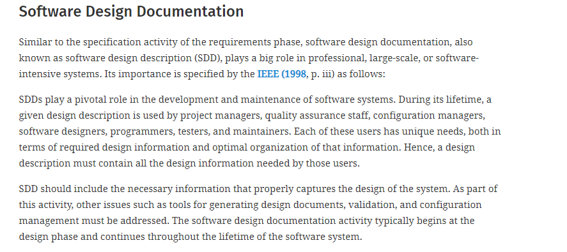

Slide 29
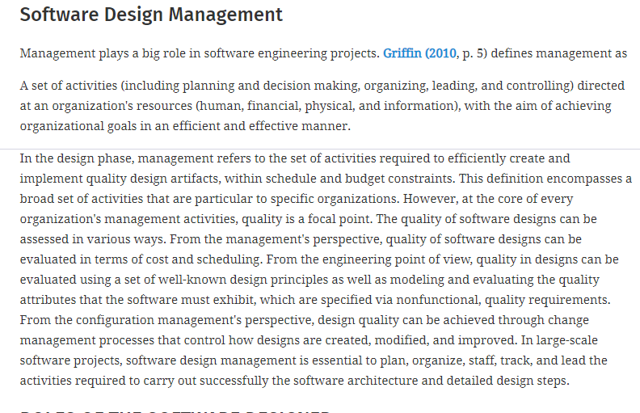

Slide 30
Software Design Process
The software design phase has several activities, each having one or more tasks.
We will spend the rest of the semester learning how to carry out major activities, how to document these efforts.

Slide 31
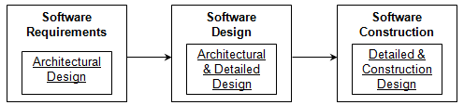
Software Design Process
In a perfect world, all design work would take place during the design phase. In practice, the distribution of design activities varies throughout the software development life-cycle.
  In most projects, most of the design efforts occur during the design phase, but some design inevitably occurs in other life-cycle phases, e.g.,
    Requirements
    Construction

Slide 32
Role of Software Designers
Systems Engineer
  Designs the overall development process of systems as a whole including processes for development of both the software and hardware that are part of the system
Software Architect
  Design software systems using mostly a black-box modeling approach; concern is placed on the external properties of software components that determine the system’s quality and support the further design of functional requirements.
Component Designer
  Focuses on designing the internal structure and behavior of software components identified during the architecture phase; typically, these designers have strong programming skills, since they implement their designs in code.
User Interface Designer
  Design the software’s user interface; skilled in determining ways that increase the usability of the system

Slide 33
Next … Software Design Fundamentals
Design Principles
  Modularization
  Abstraction
  Encapsulation
  Cohesion and coupling
  Separation of interface and implementation
  Sufficiency and completeness
Design Strategies
  Object-oriented vs. structured design
Design Considerations
  Minimize complexity and design for change

Slide 34
Software Design Fundamentals (Principles)
Design Principle #1: Modularization
  It is the principle that drives the continuous decomposition of the software system until fine-grained components are created.
  One of the most important design principle, since it allows software systems to be manageable at all phases of the development life-cycle.
  When you modularize a design, you are also modularizing requirements, programming, test cases, etc.
  Leads to designs that are easy to understand, resulting in systems that are easier to develop, maintain and re-use.

Slide 35
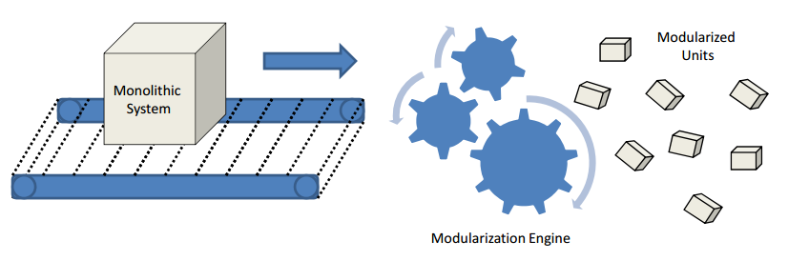
Software Design Fundamentals (Principles)
Conceptual view of modularization:
Modularization is the process of continuous decomposition of the software system until fine-grained components are created. But how do we justify the “modularization engine”?
  It turns out that two other principles can effectively guide designers during this process
    Abstraction
    Encapsulation

Slide 36
Software Design Fundamentals (Principles)
Advantages of modularization:
  Keep the complexity of a large program manageable
  Isolate errors
  Eliminate redundancies
  Encourage reuse (write libraries)
  A modular program is
    Easier to write / Easier to read / Easier to modify

Slide 37
Software Design Fundamentals (Principles)
Design Principle #2: Abstraction
  Abstraction is the principle that focuses on essential characteristics of entities—in their active context—while deferring unnecessary details.
  While the principle of modularization specifies what needs to be done, the principle of abstraction provides guidance as to how modularization should be done. Modularizing systems in ad-hoc manner leads to designs that are incoherent, hard to understand, and hard to maintain.
  Abstraction can be employed to extract essential characteristics of:
    Data
    Functions or behavior (procedures)

Slide 38
Software Design Fundamentals (Principles)
Functional (Procedural) abstraction
  Specific type of abstraction that simplifies reasoning about behavioral operations containing a sequence of steps.
  We use this all the time, e.g., consider the statement “Computer 1 SENDS a message to server computer 2”
    Imagine if we had to say, e.g., “Computer 1 retrieves the server’s information, opens a TCP/IP connection, sends the message, waits for response, and closes the connection.” Luckily, the procedural abstraction SEND helps simplify the operations so that we can reason about this operations more efficiently.
Data abstraction
  Specific type of abstraction that simplifies reasoning about structural composition of data objects.
    In the previous example, MESSAGE is an example of the data abstraction; the details of a MESSAGE can be deferred to later stages of the design phase.

Slide 39
Software Design Fundamentals (Principles)
Some advantages of abstraction
  Hides details (easier to use)
  Allows us to think about the general framework (overall solution) & postpone details for later
  Can easily replace implementations (details) by better ones

Slide 40
Software Design Fundamentals (Principles)
Design Principle #3: Encapsulation
  Principle that deals with providing access to the services of abstracted entities by exposing only the information that is essential to carry out such services while hiding details of how the services are carried out.
  When applied to data, encapsulation provides access only to the necessary data of abstracted entities, no more, no less.
  Encapsulation and abstraction go hand in hand.
    When we do abstraction, we hide details…
    When we do encapsulation, we revise our abstractions to enforce that abstracted entities only expose essential information, no more, no less.
    Encapsulation forces us to create good abstractions!
‹#›

Slide 41
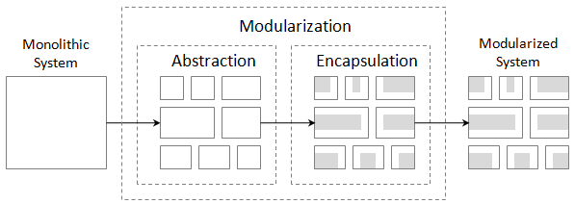
Software Design Fundamentals (Principles)
The principles of modularization, abstraction, and encapsulation can be summarized below.
Focus on essential characteristics of entities
Enforce that we only expose essential information

Slide 42
Exercise
Assume we have an online student registration system. Apply the modularization principle to decompose the system into possible fine grid of modules using
What are the possible modules that you suggest?
Discuss the issue of abstraction in relation with modularization for the modules you suggested??
(i.e. data abstraction, behavior abstraction)
Discuss encapsulation options for one of the suggested modules

Slide 43
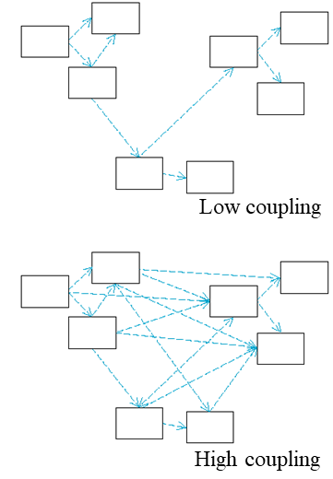
Software Design Fundamentals (Principles)
Design Principle #4: Coupling
  Refers to the manner and degree of interdependence between software modules.
  Measurement of dependency between units. The higher the coupling, the higher the dependency and vice versa.
  We should aim for lower coupling.

Slide 44
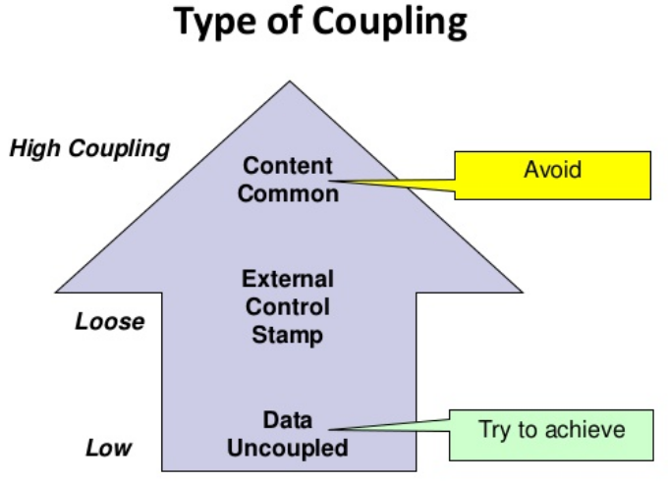
Software Design Fundamentals (Principles)
Major types of coupling include:
  Content coupling : the most severe type, since it refers to modules that modify and rely on internal information of other modules.
  Common coupling: refers to dependencies based on common access areas, e.g., global variables. When this occurs, changes to the global area causes changes in all dependent modules.

Slide 45
Software Design Fundamentals (Principles)
Major types of coupling include:
  External coupling: occurs when two modules share an externally imposed data format, communication protocol, or device interface.
  Control coupling: is one module controlling the flow of another, by passing it information on what to do (e.g., passing a what-to-do flag).
Major types of coupling include:

Slide 46
Software Design Fundamentals (Principles)
Major types of coupling include:
  Stamp coupling: occurs when modules share a composite data structure and use only parts of it, possibly different parts (e.g., passing a whole record to a function that only needs one field of it).
  Data coupling occurs when modules share data through, for example, parameters.
  No coupling: modules do not communicate at all with one another.

Slide 47
Software Design Fundamentals (Principles)
A high degree of coupling gives rise to negative side effects:
  Quality, in terms of reusability and maintainability, decrease.
  When coupling increase, so does complexity of managing and maintaining design units.

Slide 48

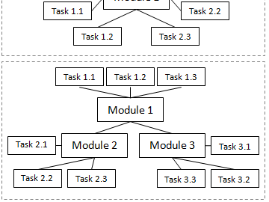
Software Design Fundamentals (Principles)
Design Principle #5: Cohesion
  The manner and degree to which the tasks performed by a single software module are related to one another.
  Measures how well design units are put together for achieving a particular tasks.
High cohesion good, low cohesion bad…

Slide 49
Software Design Fundamentals (Principles)
Cohesion can be classified as:
  Functional cohesion – all subunits contribute to perform a single function
  Procedural (or sequential) cohesion – tasks work in steps to achieve the unit’s purpose
  Temporal cohesion – all tasks in a design unit are performed at a specific time
  Communication cohesion – the unit’s tasks produce or consume the same data

Slide 50
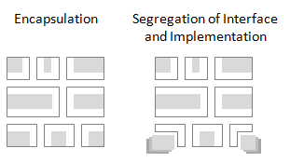
Software Design Fundamentals (Principles)
Design Principle #6: Separation of Interface and Implementation
  Deals with creating modules in such way that a stable
  interface is identified and separated from its implementation.
  Not the same thing as encapsulation!
  While encapsulation dictates hiding the details
  of implementation, this principle dictates their
  separation, so that different implementations of
  the same interface can be provided

Slide 51
Software Design Fundamentals (Principles)
Design Principle #7: Completeness
  Measures how well design units provide the required services to a achieve their intent (no less)
  Example: in detailed design, a communication class is considered complete if it provides all required services establishing /terminating a connection, sending/receiving messages. If any of these service in missing the class is considered as incomplete
Design Principle #8: Sufficiency
  Measures how well design units are providing only the services that are sufficient for achieving their intent (no more)

Slide 52
So …. To Wrap-up
Design Principles
  Modularization 🡪
  Abstraction 🡪
  Encapsulation 🡪
  Coupling 🡪
  Cohesion 🡪
  Separation of Interface and Implementation 🡪
  Completeness 🡪
  Sufficiency 🡪
Decompose into separate modules
Separate the (what) from the (how)
Information hiding
Dependency between modules
Tasks in a module
  An interface … with different implementations
All required units for achieving intent
Sufficient units for achieving intent

Slide 53
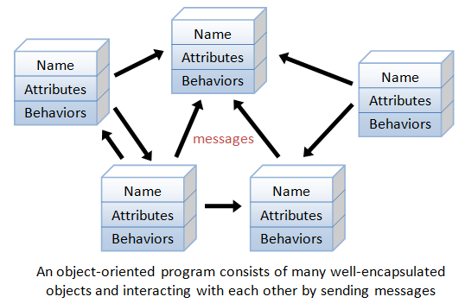
Software Design Fundamentals (Strategies)
Object-oriented design strategy
  Design strategy in which a system or component is expressed in terms of objects and connections between those objects.
  Focuses on object decomposition.
    Objects have unique identity (name)
    Objects have state (attributes)
    Objects have well-defined behavior
  Supports inheritance and polymorphism
  Appropriate for use with Object-oriented Languages

Slide 54
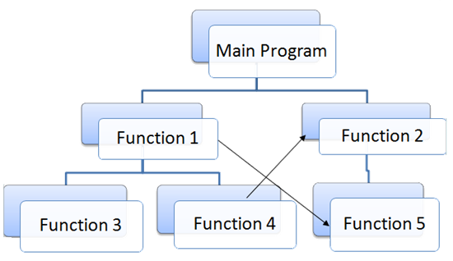
Software Design Fundamentals (Strategies)
Structured (or Functional) design strategy
  Design strategy in which a system or component is decomposed into single-purpose, independent modules, using an iterative top-down approach.
  Focuses on
    The functions that the system needs to provide,
    The decomposition of these functions, and
    The creation of modules that incorporate these functions.
  Inappropriate for use with object-oriented programming languages.

Slide 55
Software Design Fundamentals (Considerations)
Design for minimizing complexity
  Design is about minimizing complexity.
  Every decision that is made during design must take into account reducing complexity.
  When faced with competing design option, always choose the one that minimizes complexity
Design for change
  Software will change, design with extension in mind.
  A variety of techniques can be employed through the design phase to achieve this.

Slide 56
*For Next Lecture/tutorial - Exercise
Each student should prepare a mind-map for the topics that we have covered in the first chapter and how they relate with each other.
Upload your mind-map on Moodle in the Mind-Maps forum link
This should help you have an overall understanding of the topics we study
* This is required at the end of each chapter

Slide 57
Summary
Software engineering (revised)
Problem solving
Software engineering design
Why study software engineering design
Software design challenges
Software design process
Software design fundamentals
Next .. Design architecture

Slide 58
Summary (detailed)
Software engineering (revised)
  definitions
    Software
    Engineering
    Software engineering
  Software engineering phases
Problem solving
  Problem solving states
  Functional fixedness problem
  Problem solving holistic approach
Software engineering design
  Process
  Product
  Why study SE design
Software design challenges
  Requirements volatility
  Inconsistent development processes
  Fast, and ever-changing technology
  Managing design influences
  Ethical and Professional Practices

Slide 59
Summary (detailed)
Software design fundamentals
  Design principles
    Modularizations
    Abstraction
    Encapsulation
    Coupling
    Cohesion
    Separate interface from implementation
    Completeness
    Sufficiency
  Design strategies
    Object-oriented strategy
    Functional (structured) strategy
  Design considerations
    Minimize complexity
    Design for change
Software design process
  Architecture design
  Detailed design
  Construction design
  Computer-human interaction design
  Design documentation
  Management activities

